Slide 1
Computer Networks: Unit 1
Prof. Swarnalata Bollavarapu
Contact: swarnalata.b@nmims.edu

Slide 2
Contents
Communicating in a network centric world
Network as a platform
Architecture of the Internet
Classification of Networks
Layered Models
Network Addressing
Components of Network
Topology
Transmission modes
Internetworking devices
Ref Book: Mark Dye et.al, “Network Fundamentals”, CCNA Exploration Companion Guide, Cisco Press

Slide 3
H/W Q1
How many nodes were part of the ARPANET in 1969?
A) 4
B) 5
C) 6
D) 3

Slide 4
H/W Q2
Who is/are called the father/father’s of the Internet?
A) Donald Davies and Leonard
B) Robert Metcalfe
C) Kahn and Cerf

Slide 5
H/W Q2
In which year Ethernet was invented?
A) 1962
B) 1955
C) 1980
D) 1973

Slide 6
Communicating in a network centric world
Computer Network: It is a collection of autonomous computers interconnected by a single technology.
Two computers are said to be interconnected if they are able to exchange information .
The connection can be via any media(wired/wireless)
Networks come in many sizes, shapes and forms

Slide 7
Communicating in a network centric world
Communication is almost as important to us as our reliance on air, water, food, and shelter.
Methods that we use to communicate are constantly changing and evolving
Breakthroughs in technology have significantly extended the reach of our communications
Each new development has improved and enhanced our ability to connect and communicate with others.
One cannot even imagine a life without Internet today

Slide 8
Communicating in a network centric world
On daily basis,
Post and share your photographs, home videos, and experiences with friends or with the world
Communicate with friends, family, and peers using email, instant messaging, or video applications
Watch videos, movies, or television episodes on demand
Play online games with friends
check weather conditions
Find the least congested route to your destination
Check your bank balance and pay bills electronically

Slide 9
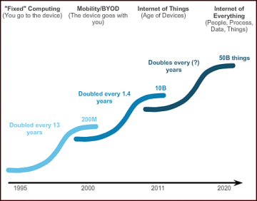
Communicating in a network centric world

Slide 10
Communicating in a network centric world
Significant impact:
1. Network support the way we learn:
2. Network support the way we communicate:
3. Network support the way we work:
4. Network support the way we play:
Whatever form it may be, networks are improving our experience

Slide 11
Communicating in a network centric world
What is communication?
How do humans communicate?
agreement on a common method
agreement on a common language
Confirmation of message
A communication protocol is a system of rules that allow two or more entities of a communications system to transmit information via any kind of variation of a physical quantity.
The protocol defines the rules, syntax, semantics and synchronization of communication and possible error recovery methods.

Slide 12
Communicating in a network centric world
What is communication?
Quality of Communication:
External factors- related to the complexity of the network and the number of devices a message must pass through
Eg., The number of other messages being transmitted simultaneously on the communication network
Internal factors-elated to the nature of the message itself.
eg., The size of the message

Slide 13
Network as a platform
Our dependency of networks has become essential for personal as well as business lives
Networks are the platforms on which to run businesses, to address emergencies, to inform individuals, and to support education, science, and government.

Slide 14
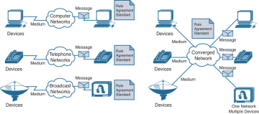
Network as platform
Early data networks were limited to exchanging character-based information between connected computer systems.
Current networks have evolved to carry voice, video streams, text, and graphics between many different types of devices.

Slide 15
Network as platform
Four basic characteristics that the N/w architectures need to address in order to meet user expectations:
Fault tolerance: how networks can manage unexpected equipment failure
Scalability: a network that will be able to efficiently expand
QoS: network can prioritize network traffic to provide users with reliable quality of service,
Security: securing information as well as n/w infrastructure

Slide 16
Components of network
End devices: interface between users and the underlying communication network.
Eg., Computers (work stations, laptops, file servers, web servers)
A host device is either the source or destination of a message transmitted over the network.
Intermediary devices: interconnect end devices, multiple individual networks
Eg.,switches, routers
Network media: The medium provides the channel over which the message travels from source to destination.
Eg., Copper wires, fiber-optic cables and wireless transmission

Slide 17
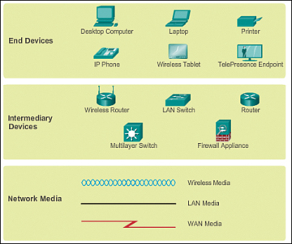
Components of network
Network representation:
A diagram provides an easy way to understand the way the devices in a large network are connected, known as topology diagram

Slide 18
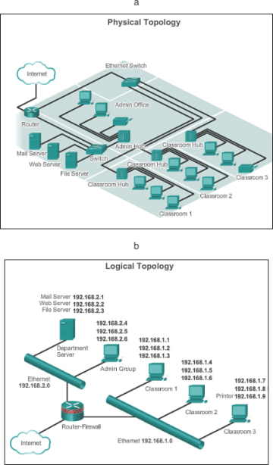
Topology
Network topology is the
physical interconnection of
the elements of a computer
Network
Types:
Bus
Ring
Star
Mesh
Hybrid

Slide 19
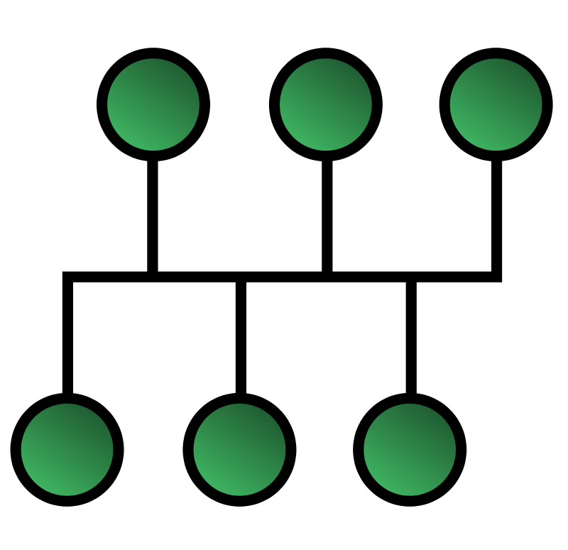
BUS Topology
In a bus network, every device is connected to a single cable that runs from one end of the network to the other
at any instant at most one machine is the master and is allowed to transmit.
All other machines are required to refrain from sending.
Some mechanism is needed to resolve conflicts when two or machines want to transmit simultaneously.
For example : IEEE 802.3, Ethernet.
Computers on an Ethernet can
transmit when ever they want to;
if two or more packets collide,
each computer just waits a random
time and tries again later.

Slide 20
RING Topology
each computer is connected to the network in a closed loop or ring.
Each machine or computer has a unique address that is used for identification purposes.
The signal passes through each machine or computer connected to the ring in one direction.
Ring topologies typically utilize a token passing scheme, used to control access to the network.
By utilizing this scheme, only one machine can transmit on the network at a time.

Slide 21

RING Topology
The machines or computers connected to the ring act as signal boosters or repeaters which strengthen the signals that transverse the network.
The primary disadvantage of ring topology is the failure of one machine will cause the entire network to fail.

Slide 22

Star Topology
every node is connected to a central node called a hub or switch

Slide 23
Components of network
Important terms:
Network interface card (NIC): Provides the physical connection to the network at the PC or other host device. The media connecting the PC to the networking device plugs directly into the NIC (also known as a LAN adapter).
Physical port: A connector or outlet on a networking device where the media is connected to a host or other networking device.
Interface: Specialized ports on an internetworking device that connect to individual networks. Because routers are used to interconnect networks, the ports on a router are referred to as network interfaces.

Slide 24
Types of Network
Depends on:
Size of the area covered
Number of users connected
Number and types of services available
Types:
LAN
MAN
WAN
Wireless network
Internet

Slide 25
Types of Network: LAN
spans a small geographical area
LANs interconnect end devices in a limited area such as a home, school, office building, or campus.
A LAN is usually administered by a single organization or individual. The administrative control that governs the security and access control policies are enforced on the network level.
LANs provide high-speed bandwidth to internal end devices and intermediary devices.
LANs run at speed s of 10 Mbps to 100 Mbps.
Newer LANs operate upto 10 GBPs.

Slide 26
Types of Network: MAN
A network infrastructure that spans a physical area larger than a LAN but smaller than a WAN (for example, a city).
MANs are typically operated by a single entity such as a large organization.
Example: A MAN is the cable television network available in many cities.

Slide 27
Types of Network: WAN
spans a wide geographical area.
WANs interconnect LANs over wide geographical areas such as between cities, states, provinces, countries, or continents.
WANs are usually administered by multiple service providers.
WANs typically provide slower-speed links between LANs.

Slide 28
Concluding Remarks
H/W:

Slide 29
Wireless Networks
Wireless network can be divided into three main categories.
System interconnection.
Wireless LANs.
Wireless WANs.

Slide 30
System Interconnection
System interconnection is all about interconnecting the components of computer using short range radio.
To connect these components short range wireless network is used, which is known as BLUETOOTH.
Bluetooth uses a radio technology called frequency-hopping spread spectrum, which chops up the data being sent and transmits chunks of it
It can achieve a gross data rate of 1 Mb/s.
Bluetooth provides a way to connect and exchange information between devices such as mobile phones, telephones, laptops, personal computers, printers, Global Positioning System (GPS) receivers, digital cameras, and video game console.

Slide 31
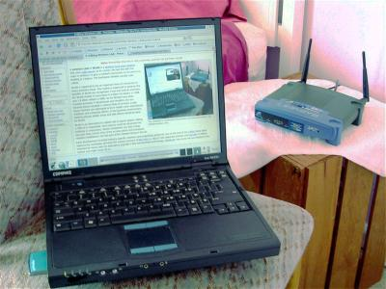
Wireless LANs
These are the systems in which every computer has modem and antenna with which it can communicate.
For the home user, wireless has become popular due to ease of installation, and location freedom with the gaining popularity of laptops.
IEEE 802.11 is the wireless standard

Slide 32
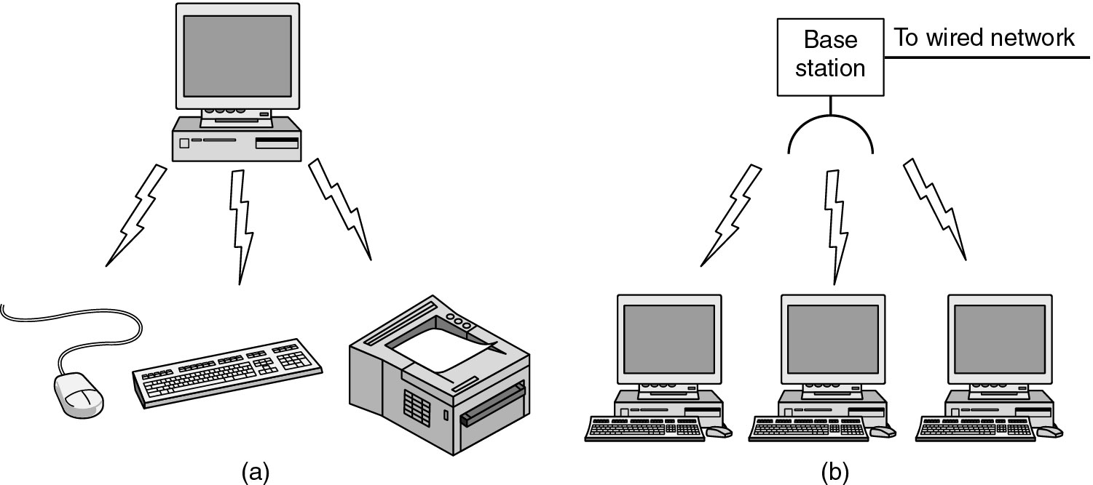
Wireless Networks (2)
(a) Bluetooth configuration
(b) Wireless LAN

Slide 33
Architecture of Internet
the Internet is a worldwide collection of interconnected networks (internetworks or internet for short), cooperating with each other to exchange information using common standards
It is not owned by any individual or group.
Internet Engineering Task Force (IETF) along with some other organization helps to maintain the structure and standardization of Internet protocols and processes
Terms similar to Internet are : Intranet and Extranet
Intranet is a term often used to refer to a private connection of LANs and WANs that belongs to an organization, and is designed to be accessible only by the organization’s members, employees, or others with authorization.
An organization can use an extranet to provide secure and safe access to individuals who work for a different organization, but require company data. Examples of extranets include
A company providing access to outside suppliers/contractors
A hospital providing a booking system to doctors so that they can make appointments for their patients

Slide 34
Architecture of Internet

Slide 35
Architecture of Internet
https://youtu.be/7_LPdttKXPc
<iframe width="545" height="409" src="https://www.youtube.com/embed/7_LPdttKXPc" frameborder="0" allow="accelerometer; autoplay; encrypted-media; gyroscope; picture-in-picture" allowfullscreen></iframe>

Slide 36
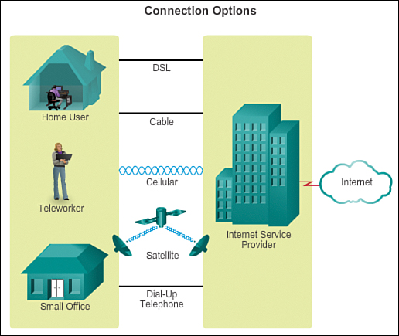
Architecture of Internet
To join the Internet, the computer is connected to an Internet Service Provider
There are many kinds of Internet access, and they are usually distinguished by how much bandwidth they provide and how much they cost

Slide 37
Challenges
Complex system:
Many users
World-wide reach
Many user requirements –reliable, interactive, multicasting
Heterogenous technology: Ethernet, Wireless etc
Object-oriented approach:
Segregate functionality
Abstraction-provide interface

Slide 38
Layered Model
Advantages of layering
Modular design—less complex
Software reuse
Abstraction of implementation

Slide 39
Contents
Communicating in a network centric world
Network as a platform
Architecture of the Internet
Classification of Networks
Layered Models
Network Addressing
Components of Network
Topology
Transmission modes
Internetworking devices
Ref Book: Mark Dye et.al, “Network Fundamentals”, CCNA Exploration Companion Guide, Cisco Press

Slide 40
Network software
Protocol Hierarchies (Layer structure)
•Design Issues for the Layers
•Connection-Oriented and Connectionless Services
•Service Primitives
•The Relationship of Services to Protocols

Slide 41
Network Software
Protocol:
Protocol is an agreement between the communicating parties on how communication is to proceed.
The protocols define the following:
■ The format of the message, such as how much data to put into each segment
■ The way intermediary devices share information about the path to the destination
■ The method to handle update messages between intermediary devices
■ The process to initiate and terminate communications between hosts
Example: interaction between a web server and a web browser.
This interaction uses a number of protocols and standards in the process of exchanging information between them. The different protocols work together to ensure that the messages are received and understood by both parties

Slide 42
Network Software
Protocol Hierarchies :
a series of layers (levels)
–lower layer provides service to higher layers
–protocol:
•an agreement between the communication parties on how communication is to proceed
–Peers:
•the corresponding layers on different machines.
–Network architecture: a set of layers and protocols
–Protocol stack:
•a list of protocols used by a certain system, one protocol per layer

Slide 43
Network Software
Two networking models:
The TCP/IP model is a protocol model because it describes the functions that occur at each layer of protocols within the TCP/IP suite.
OSI model: primary purpose of a reference model is to aid clearer understanding of the functions and process involved

Slide 44
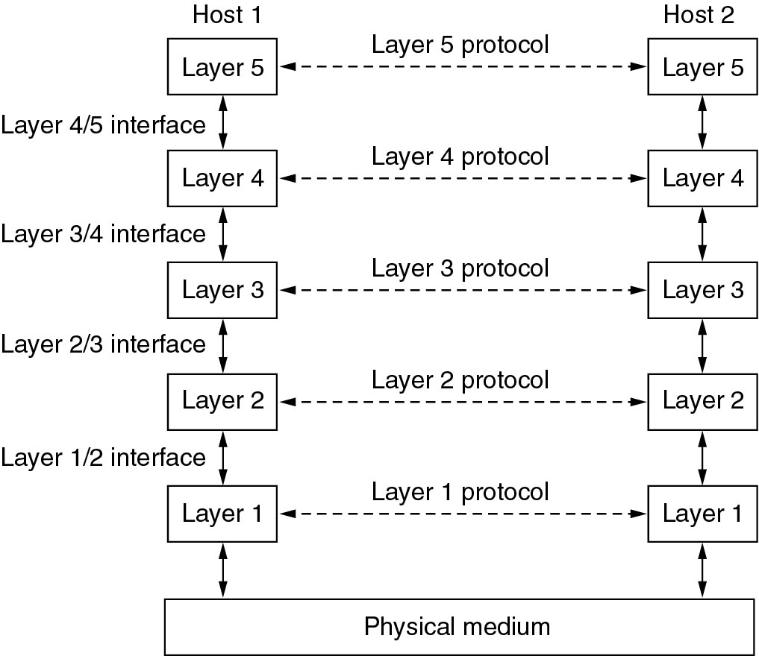
Network Software Protocol Hierarchies
Layers, protocols, and interfaces.

Slide 45
Protocol Hierarchies
Instead each layer passes data and control information to the layer immediately below it, until the lowest layer is reached.
Below layer 1 is the physical medium through which actual communication occurs.
Interface defines which primitive operations and services the lower layer makes available to the upper one.
A set of layers and protocols is called a network architecture.
It is not necessary that all the protocols are used by all the system.
List of protocols used at each layer in machine is known as protocol stack.

Slide 46
Protocol Hierarchies (2)
The philosopher-translator-secretary architecture.

Slide 47
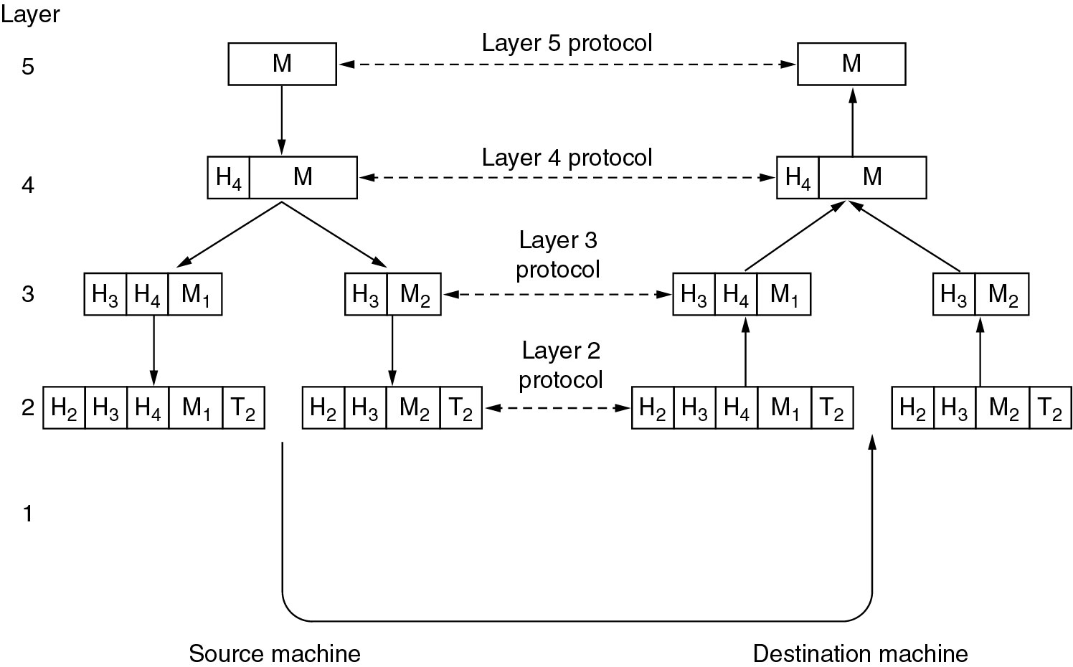
Protocol Hierarchies (3)
Example information flow supporting virtual communication in layer 5.

Slide 48
Design Issues for the Layers
Addressing
Error Control
Flow Control
Multiplexing
Routing

Slide 49
Design Issues -Addressing
Every layer needs a mechanism for identifying senders and receivers.
Since a network normally has many computers, some of which have multiple processes, a means is needed for a process on one machine to specify with whom it wants to talk.
Some form of addressing is needed in order to specify a specific destination.

Slide 50
Design Issues – Data Transfer
Another set of design decisions concerns the rules for data transfer.
In some systems, data only transfer in one direction, in others data can transfer in both direction.
It is needed to decide whether there will be simplex communication, duplex communication.

Slide 51
Design Issues – Error Control
Physical communication channels are not perfect.
Many error correcting and error detecting codes are available, but systems need to agree upon which to use.
There should be some mechanism for receiver informing sender about which message has been correctly received and which are not.

Slide 52
Design Issues – Sequencing
Order of messages may or may not be preserved by communication channels.
To deal with a possible loss of sequencing, the protocol must make explicit provision for receiver to allow the pieces to be reassembled properly.
An obvious solution is to number the pieces.

Slide 53
Design Issues – Flow Control
An issue that occurs at every level is how to keep a fast sender from swamping a slow receiver with data.
One solution is feedback from receiver to the sender either directly or indirectly about the receiver's current situation.
This is called flow control.

Slide 54
Design Issues – Long and short Messages
Another problem that must be solved at several levels is the inability of all processes to accept arbitrarily long messages.
This property leads to mechanisms for disassembling, transmitting and then reassembling messages.
What to do when processes insist on transmitting data in units that are too small that sending each one separately is inefficient.
solution is to gather several small messages heading toward a common destination into a single large message and dismember the large message at the other side.

Slide 55
Design Issues – Routing
When there are multiple path between source and destination, a route must be chosen.
Choosing optimal routing technique is also a design issue.
This is known as routing.

Slide 56
Connection Oriented Service and Connectionless Services
Connection oriented service are modeled after the telephone system.
To talk to someone
Pick up the phone
Dial the number | Establish the connection
Talk | Use the connection to transmit
Hang up | Release the connection

Slide 57
Connection Oriented Service and Connectionless Services
In some cases when a connection is established, the sender, receiver conduct a negotiation about parameters to be used, such as maximum message size, quality of service required and other issues.
One side makes a proposal and other side can accept it, reject it or counter proposal it.

Slide 58
Connection Oriented Service and Connectionless Services
Connection less service is modeled after the postal system.
No prior connection need to be established.
Each message(letter) carries the full destination address, and each one is routed through the system independent of all others.
Normally when two messages are sent to the same destination, the first one sent will be the first one to arrive.
But it is also possible that the first one sent can be delayed so that the second one arrives first.

Slide 59
Connection Oriented Service and Connectionless Services
Each service can be characterized by a quality of service.
Some services are reliable in the sense that they never lose data.
A reliable service is implemented by having the receiver acknowledge the receipt of each message so the sender is sure that it arrived.
Example for reliable connection oriented service: File transfer.
The owner of file wants to be sure that all the bits arrive correctly and in the same order they were sent.

Slide 60
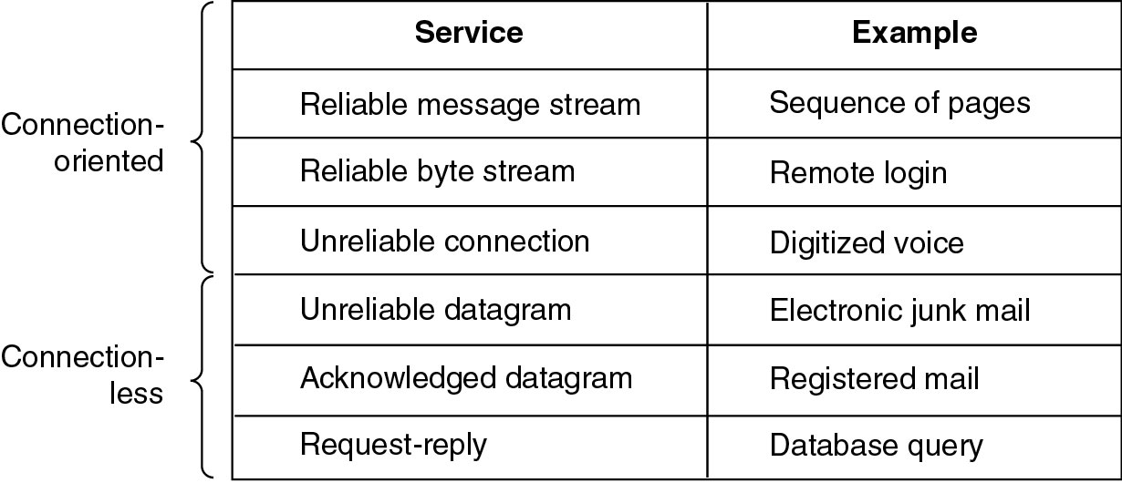
Connection-Oriented and Connectionless Services
Six different types of service.

Slide 61
Service Primitives
A service is specified by a set of primitives(operations) to a user process to access the service.
These primitives tell the service to perform some action.
The primitives for connection oriented service are different from connection less service.

Slide 62
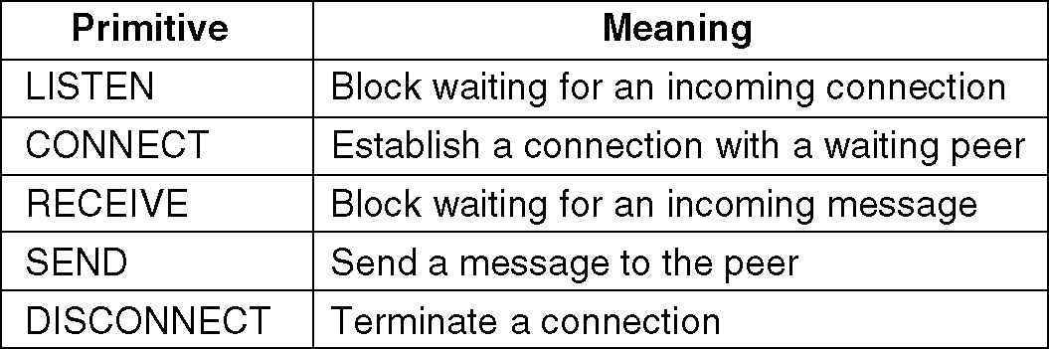
Service Primitives
Five service primitives for implementing a simple connection-oriented service.

Slide 63
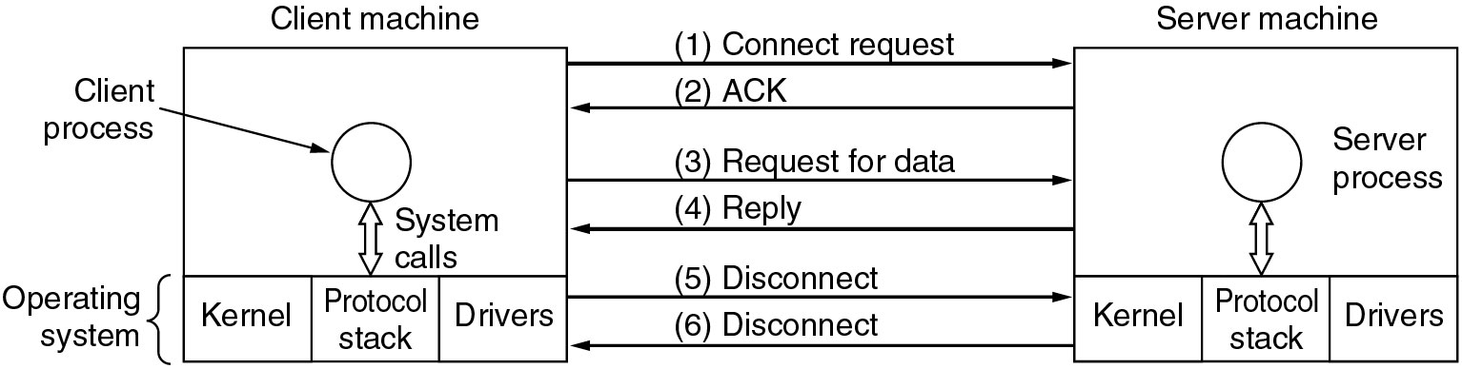
Service Primitives (2)
Packets sent in a simple client-server interaction on a connection-oriented network.

Slide 65
Recap
What is layering?
Importance of layered model for N/w communication
Understanding of peers, Layer, Protocol, service and Interface
Design issues with Layers: Message size, routing etc…
Connection oriented vs Connectionless services
Service primitives
Two Networking models

Slide 66
OSI Reference Model
Based on the proposal developed by international standard organization (ISO)
The model is called the ISO OSI(Open Systems Interconnection) Reference Model.
It deals with connecting open systems – that is, systems that are open for communication with other systems.
The OSI model has seven layers.

Slide 67
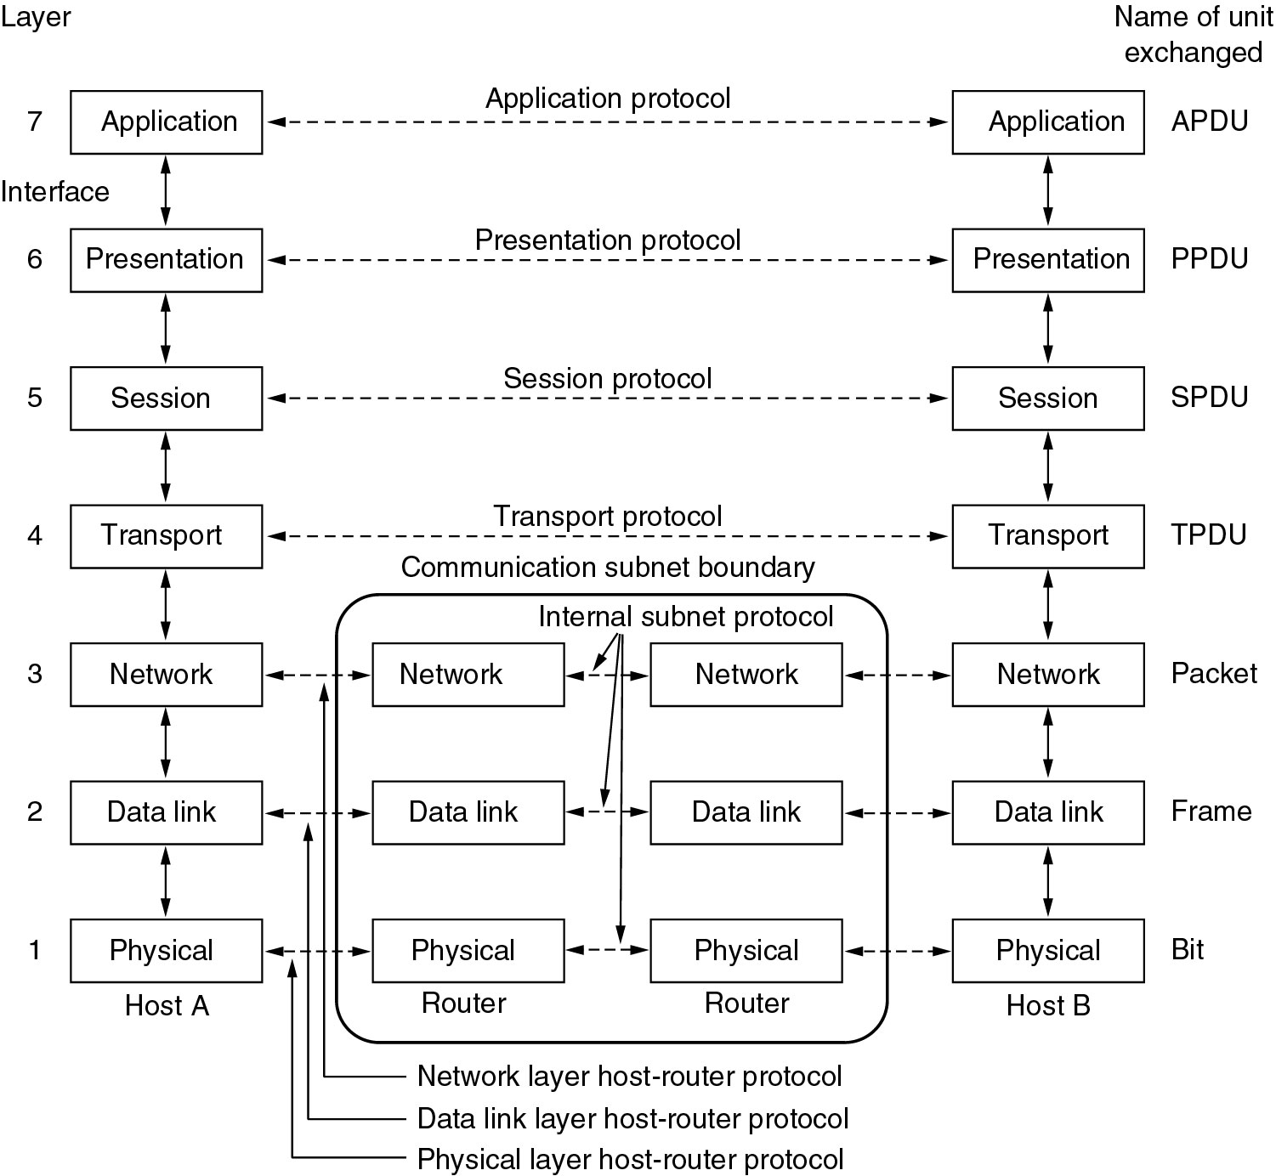
OSI Reference Model

Slide 68
Functions of layers
The physical layer is concerned with transmitting raw bits over a communication channel
•The data link layer performs flow control and also transforms a raw transmission facility into a line that appears error free
•The network layer controls the operation of the subnet, e.g. routing, flow control, internetworking,…
•The transport layer performs assembling and disassembling, isolates the upper layers from the changes in the network hardware, and determines the type of services
•The session layer establishes sessions (dialog control, …)
•The presentation layer is concerned with the syntax and semantics
•The application layer contains a variety of commonly used protocols (e.g. Hyper Text Transfer Protocol for WWW, file transfer, e-mail…)

Slide 69
Network Addressing
With millions of computers in use on the web, so proper addressing is essential to make sure that the sent message arrives intact at the proper destination
Getting data through the internetwork– IP Addressing
Getting data to the end device– MAC addressing
Getting data to the right application/process—Port Addressing

Slide 70
Network Addressing
Getting data through the internetwork:
Layer 3 protocols are primarily designed to move data from one local network to another local network within an internetwork
At the boundary of each local network, an intermediary network device, a router, decapsulates the frame to read the destination host address contained in the header of the packet, the Layer 3 PDU.
Routers use the network identifier portion of this address to determine which path to use to reach the destination host. When the path is determined, the router encapsulates the packet in a new frame and sends it on its way toward the destination end device.

Slide 71
Network Addressing
Getting data to the end device:
Layer 2 is concerned with the delivery of messages on a single local network.
The Layer 2 address is unique on the local network and represents the address of the end device on the physical media.
The physical address comes from codes placed on the NIC by the manufacturer.
In a LAN using Ethernet, this address is called the MAC address.
The terms physical address and MAC address are often used interchangeably

Slide 72
Network Addressing
Getting data to the right application:
People using PCs often have an e-mail client running at the same time as a web browser, an instant messaging program, some streaming media, and perhaps even a game.
All these separately running programs are examples of individual processes.
A port number is used identify a specific process or service running on the destination host device that will act on the data being delivered.
Hosts, whether they are clients or servers on the Internet, can run multiple network applications simultaneously.

Slide 73
Recap
Overview of OSI model
Network Addressing

Slide 74
Transmission modes
Transmission mode means transferring of data between two devices. It is also known as communication mode.
Simplex mode
Half-duplex mode
Full-duplex mode

Slide 75
Transmission modes
Simplex mode
In Simplex mode, the communication is unidirectional, as on a one-way street.
Only one of the two devices on a link can transmit, the other can only receive. Example: Keyboard and traditional monitors. The keyboard can only introduce input, the monitor can only give the output.

Slide 76
Transmission modes
Half-Duplex mode
In half-duplex mode, each station can both transmit and receive, but not at the same time.
When one device is sending, the other can only receive, and vice versa. The entire capacity of the channel can be utilized for each direction. Example: Walkie- talkie in which message is sent one at a time and messages are sent in both the directions.

Slide 77
Transmission modes
Full-Duplex mode
In full-duplex mode, both stations can transmit and receive simultaneously.
In full-duplex mode, signals going in one direction share the capacity of the link with signals going in other direction

Slide 78
Internetworking/Intermediary devices
End devices are the hosts that initiate communications
Getting a message from the source to the destination can be a complex task involving several intermediary devices along the way.
Intermediary devices connect the individual hosts to the network and can connect multiple individual networks to form an internetwork.
- Network access devices: Connect end users to their network. Examples are hubs,
switches, and wireless access points.
- Internetwork devices: Connect one network to one or more other networks. Eg.,
Routers, Gateways
- Communication servers: Route services such as IPTV and wireless broadband.
- Modems: Connect users to servers and networks through telephone or cable.
- Security devices: Secure the network with devices such as firewalls that
analyze traffic exiting and entering networks.

Slide 79
Internetworking/Intermediary devices
Processes running on the intermediary network devices perform these
functions:
■Regenerate and retransmit data signals
Maintain information about what pathways exist through the network and internetwork
■ Notify other devices of errors and communication failures
■ Direct data along alternate pathways when there is a link failure
Classify and direct messages according to quality of service (QoS) priorities
■ Permit or deny the flow of data, based on security settings

Slide 80
Internetworking devices
Repeater: electronic device that receives a signal and retransmits it at a higher level or higher power, so that the signal can cover longer distances without degradation
they operate on the Physical layer
Hub: physical layer device containing multiple ports allows for connections from many computers
When a packet arrives at one port, it is copied to all the ports of the hub
It offers ease of use but collision domain is high
A collision domain is a network segment connected by a shared medium or through repeaters where simultaneous data transmissions collide with one another.
A network collision occurs when more than one device attempts to send a packet on a network segment at the same time.

Slide 81
Internetworking devices
Bridge: operates at data link layer. A bridge is a repeater, with add on functionality of filtering content by reading the MAC addresses of source and destination.
It is also used for interconnecting two LANs working on the same protocol. It has a single input and single output port, thus making it a 2 port device.
Switch: (layer 2 device) originally known as switching hub, operate at data link layer
Can inspect the ethernet traffic hence sending data to whom it is intended to
The switch can perform error checking before forwarding data making it very efficient
Used to connect computers on a single network usually referred to as LAN

Slide 82
Internetworking devices
Router: device that knows how to forward data between independent networks
Operates at network layer
Routers normally connect LANs and WANs together and have a dynamically updating routing table based on which they make decisions on routing the data packets.
Gateway: A gateway is a passage to connect two networks together that may work upon different networking models.
They basically work as the messenger agents that take data from one system, interpret it, and transfer it to another system.
Gateways are also called protocol converters and can operate at any network layer. Gateways are generally more complex than switch or router

Slide 83
Reflection Question 1
What's the difference between full and half duplex?
Full duplex is slower than half duplex.
Full duplex allows communications in two directions at the same time; half duplex means that only one side can communicate at a time.
Full duplex is a form of simplex communications.
Half duplex occurs when hubs are in use; full duplex occurs when switches are in use

Slide 84
Reflection Question 1
What's the difference between full and half duplex?
Full duplex is slower than half duplex.
Full duplex allows communications in two directions at the same time; half duplex means that only one side can communicate at a time.
Full duplex is a form of simplex communications.
Half duplex occurs when hubs are in use; full duplex occurs when switches are in use

Slide 85
Reflection Question 2
Which of the following statements accurately describe the differences between a hub and a switch? Check all that apply.
A switch remembers which devices are connected on each interface, while a hub does not.
A hub causes larger collision domains.
Hubs are more sophisticated versions of switches.
A hub is a physical layer device, and a switch is a data link layer device.

Slide 86
Reflection Question 2
Which of the following statements accurately describe the differences between a hub and a switch? Check all that apply.
A switch remembers which devices are connected on each interface, while a hub does not.
A hub causes larger collision domains.
Hubs are more sophisticated versions of switches.
A hub is a physical layer device, and a switch is a data link layer device.

Slide 87
Reflection Question 3
What's the difference between a client and a server?
A server requests data, and a client responds to that request.
Clients operate on the data link layer, and servers operate on the network layer.
A client requests data, and a server responds to that request.
Clients and servers are different names for the same thing.

Slide 88
Reflection Question 3
What's the difference between a client and a server?
A server requests data, and a client responds to that request.
Clients operate on the data link layer, and servers operate on the network layer.
A client requests data, and a server responds to that request.
Clients and servers are different names for the same thing.

Slide 89
Reflection Question 4
What's a router?
A network device used specially for fiber cables
A physical layer device that prevents crosstalk
A device that knows how to forward data between independent networks
A more advanced version of a switch

Slide 90
Reflection Question 4
What's a router?
A network device used specially for fiber cables
A physical layer device that prevents crosstalk
A device that knows how to forward data between independent networks
A more advanced version of a switch

